Slide 1
Eress Energy Metering Day 21/10/2025
21/10/2025 – A.Fiengo

Slide 2
REM2000 EMS OF THE NEW GENERATION
AGENDA
Generations of Product
REM2000 main capabilities
REM2000 Compatibility with previous generations
Q&A

Slide 3


Key EVOLUTIONS ACROSS GENERATIONS
REM101
REM102
REM2000
REM100
2026
2016-2026
REM102 FUNCTIONS +
Full Modularity (HW and SW)
64bit multicore CPU
Full Cybersecurity
5G with eSIM
Realtime I,V analysis and log
Energy/Power quality
EN50453:202x Full Compliance
IEC 62888:202x Full Compliance
REM101 FUNCTIONS +
Wide range sensor IF
Wide range power supply
Multi traction networks
2G/3G/4G+GPS
TCMS IF (TRDP,CIP,MVB, NMEA)
DigIO
Distributed architecture
Basic Cybersecurity
Metrological SW core independent from Fieldbus
EN50453:2017 Full Compliance
Mass introduction in Europe
2007-2018
- Sensor specific
- Mainly DC networks
- 2G+GPS
EN50453:2007 Compliance
- Mass introduction in the UK Market
2003-2006
Concept
Small trials in Italy

Slide 4
REM2000 Main Features
Ultracompact and robust mechanical design
Enhanced flexibility due to HW/SW Modularity
FFF with previous generations
Latest radio technologies
Enhanced cybersecurity features
Realtime Readings and post processing

Slide 5
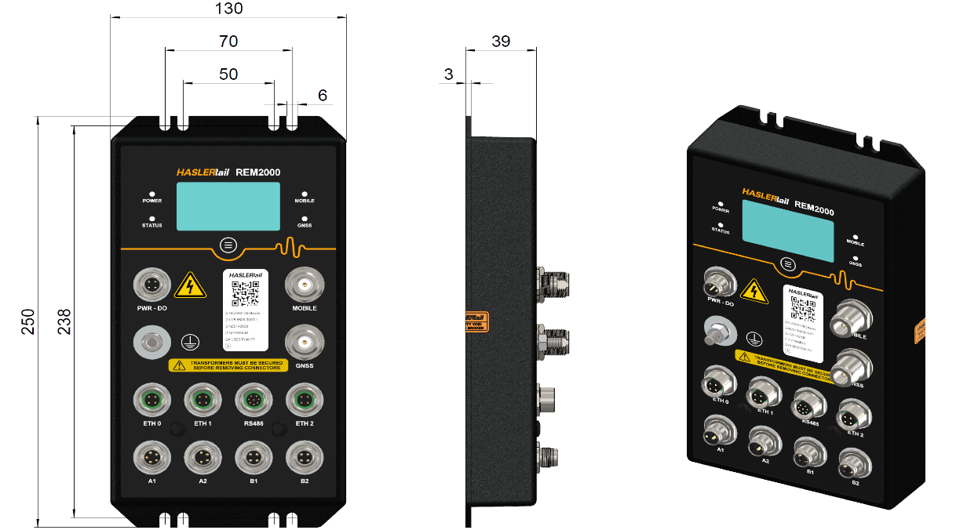
REM2000 Main Features
Ultracompact and robust mechanical design
Robust metallic housing for harsh environment
All orientation installation
All connectors on a single surface and coded
IP54 grade
OLED graphic display 2.42” high contrast (10,000:1)
-40°C :+70°C operating temperature
Improved reliability performance

Slide 6
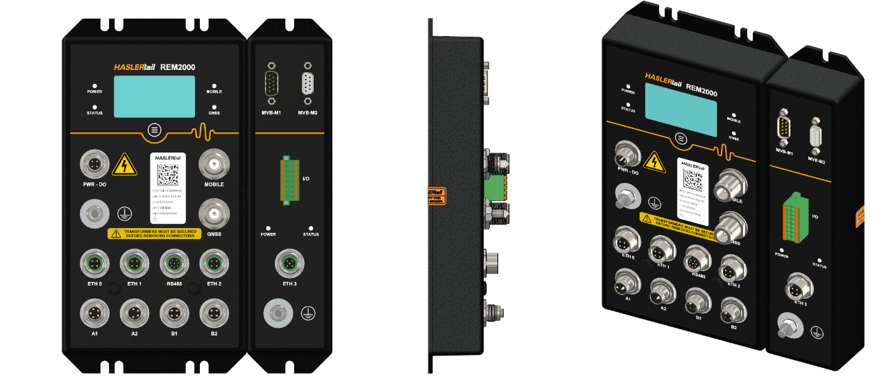
REM2000 Main FeatureS
Enhanced flexibility due to HW/SW Modularity
HW aspects:
At device level: Base module + Expansion module
At module level tailored for use cases managed via mounting options:
Base module
2x independent AC/DC full range analog input modules
(AC, DC, AC-AC; AC-DC: DC-AC; DC-DC; none)
Radio/GPS module (N-type with SMA upon request)
Display module
RS485 IF for DMETER/RTP100 IF
2x ETH IF + with 1x additional for expansion module
1x precise 3 axes accelerometer
b) Expansion module:
MVB IF
4x Digital inputs 4x Digital output
Local or remote installation (25mt+)

Slide 7
REM2000 Main FeatureS
Enhanced flexibility due to HW/SW Modularity
SW/Functional aspects:
Full compliance with
EN50716:2023 (supersedes the EN50657);
EN50463:202x
IEC6288:202x
Based of existing up to date company SW platform
Kept full independence from metrological SW SCI and non metrological SW SCI and related configuration
Permit rapid customization implementations without the need to repeat TSI/EN50463 re-homologation process
On the non-metrological SCI are available:
TCMS related capabilities
Energy benchmark features
Energy/power quality features
General purpose digital IO management
Catenary related monitoring (arc detection, real-time V,I,P,a)
Any specific customer functionality (protocol, energy split/aggregation)
Advanced Distributed system architecture:
Multiple REM2000 and smart sensors can be connected over ETH network forming a complex EMS network
Redundant DHS setup
Distribution over ETH of VMF(DC only) and ECFs permit system cost optimization and energy benchmark on train subsystem level
Integration with train protection devices (catenary, over voltage, short circuit, harmonic detections)

Slide 8
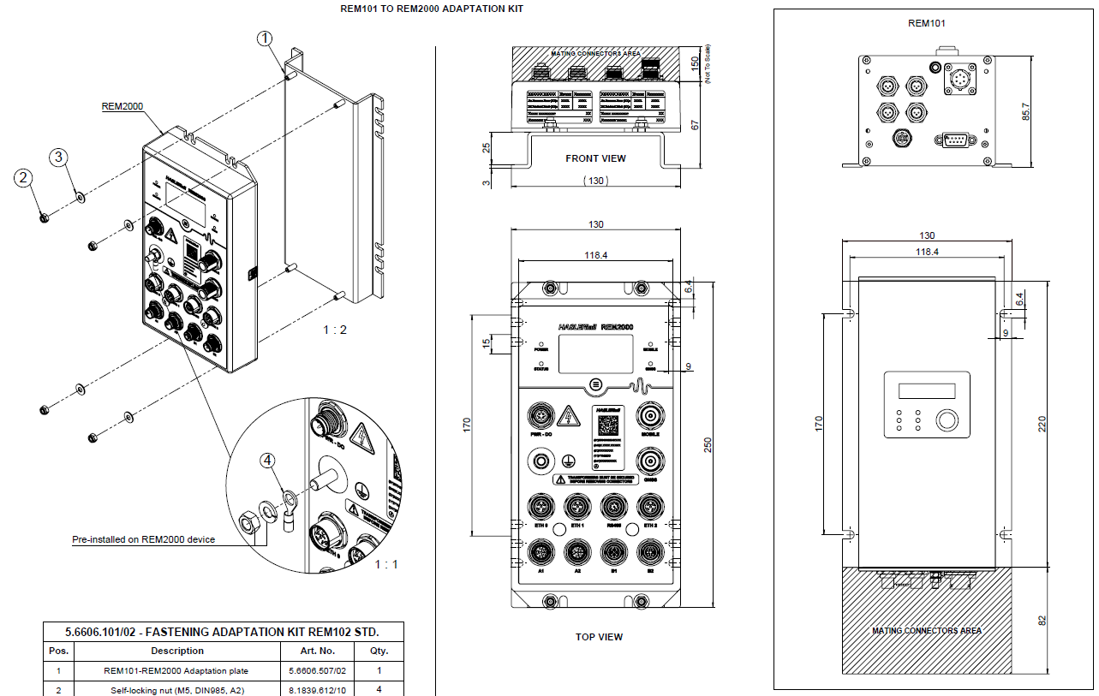
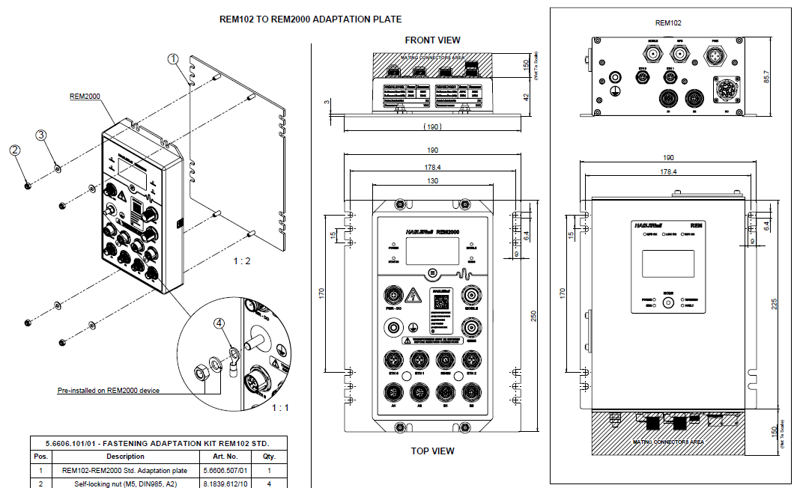
REM2000 Main FeatureS
FFF with previous generations
Using some predefined mech kits is possible to replace FFF REM101 and REM102 with REM2000 if needed. No additional space occupation is implied.
Some connectors of the previous generation has changed so only cable re-crimping may be needed.
Replacement of REM101
Replacement of REM102

Slide 9
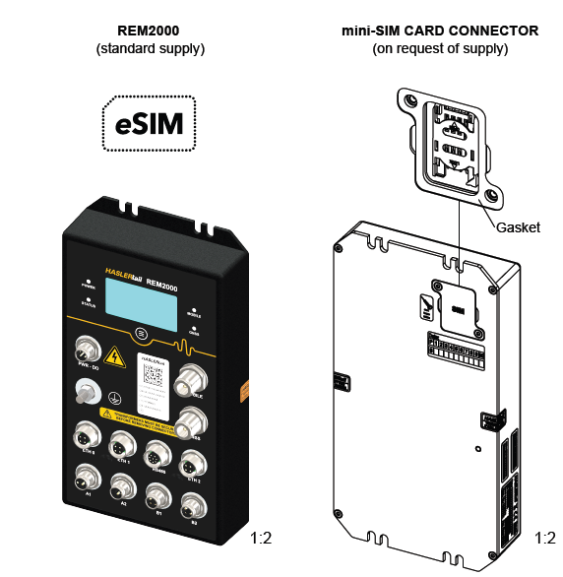
REM2000 Main FeatureS
Latest radio technologies:
Connected to 2G/3G/4G/5G networks
fallback 4G to 2/3G and 5G to 2/3/4G (LTE Cat 4 and 3GPP Rel-17 Redcap. 5G NR sub-6)
Integrated eSIM solution supporting latest SGP.22 protocols
Bootstrap profile provided by Haslerrail (no need of external internet connection to permit mobile radio commissioning)
Possibility to have data management done by the final customer or by the integrator/Haslerrail
Specific HW variant compliant also with old mini SIM solution
Build-in multi-constellation GNSS receiver
GPS/GLONASS/BDS/Galileo/NavIC

Slide 10
REM2000 Main Features
Enhanced cyber security features:
SL-C vector equal to (2,2,2,2,4,2,2).
State of the art cybersecurity SW architecture
State of the art processing core (64Bit multicore)
HTTPS/SFTP secure precools available
Processes:
SW Design following SANS-25 and OWSAP-10 guidelines
Threats and Risk Analysis procedures
Periodic vulnerability scan using OpenVAS and Lynis
Linux OS, application versions monitored and where applicable maintained continuously
CS Patch management
The overall cyber security related development in HR refers to the following standards:
IEC 62443-4-1
IEC 62443-4-2
ISO 27001

Slide 11
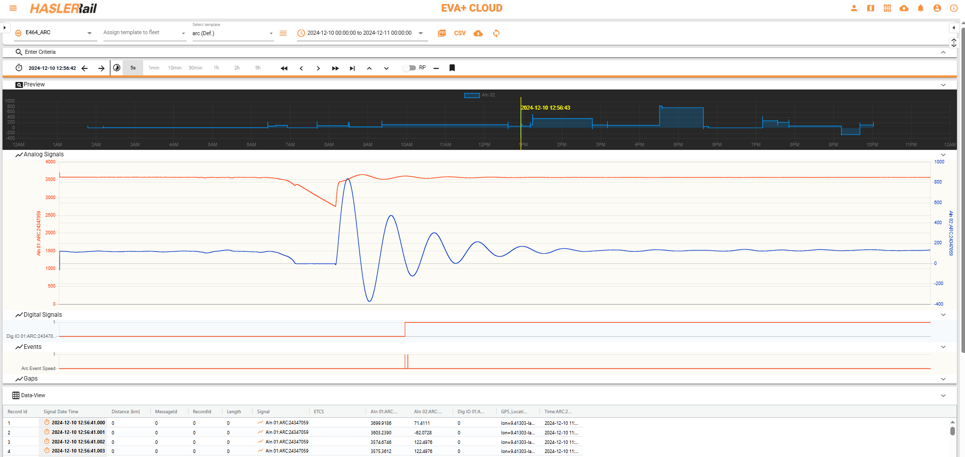
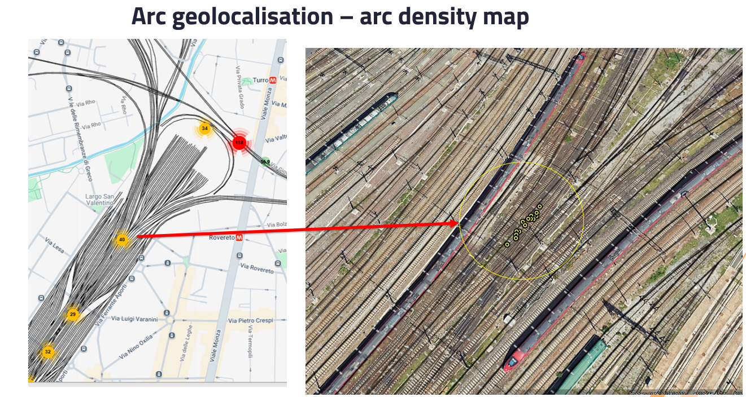
REM2000 Main Features
Realtime signal processing:
Realtime monitor of V,I,P,a signal and related post processing permits:
Panto-Catenary contact continuous monitoring (arc detections, signal anomaly detection)
Power quality
High speed and high data throughput vs EVA+ cloud system
High resolution data management (storage and transfer to DCS)

Slide 12
Questions?

